Slide 1

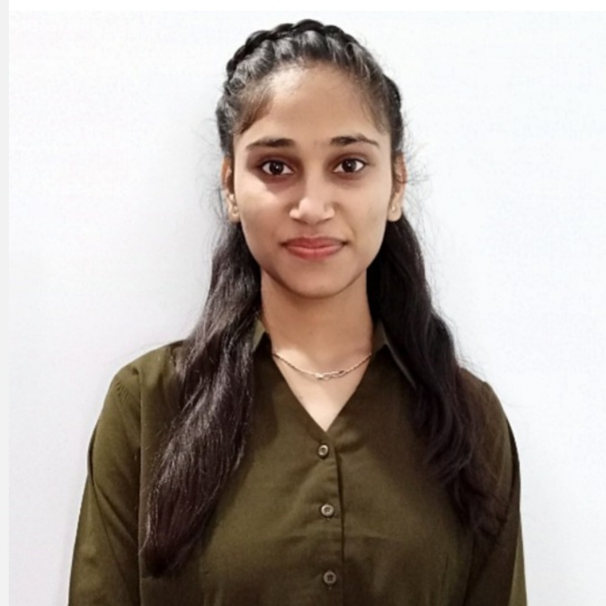
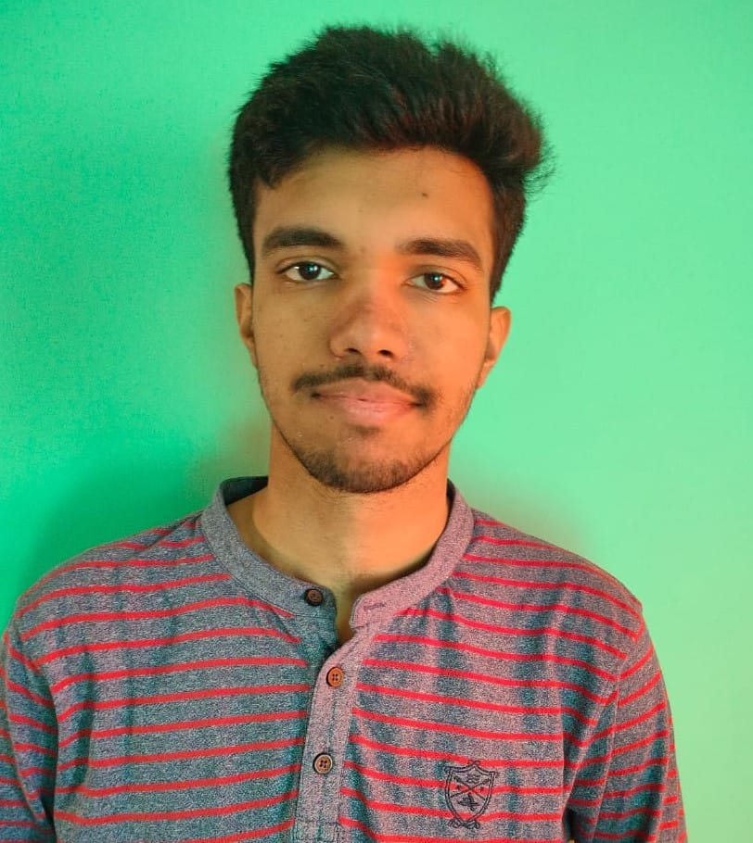
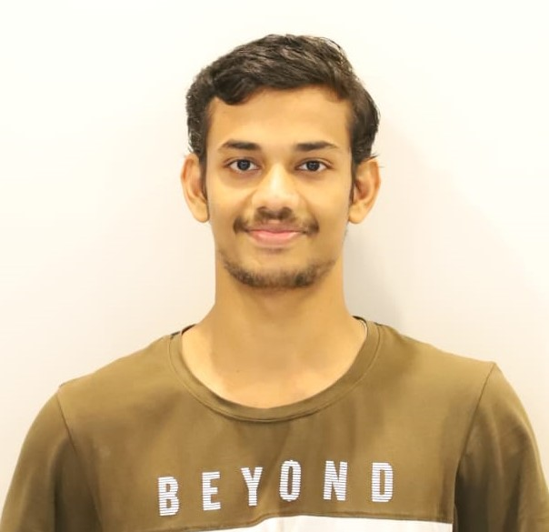

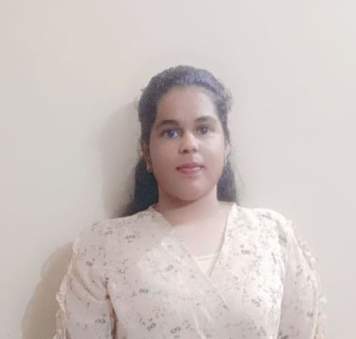
GenZ Autocrats
Tanu Chandravanshi
VIT Bhopal University
2022-2026
Subhjeet Tiwari
VIT Bhopal University
2021-2025
Praveen N Swamy
VIT Bhopal University
2021-2025
Abhishek Kumar
VIT Bhopal University
2021-2025
Harpreet Kour
VIT Bhopal University
2022-2026

Slide 2
Tell us a bit about yourself
We have worked on some good projects like an AI human detector using Python, cloned the website of LinkedIn, made apps using Flutter currently working on our project AuthentiScan.
(https://github.com/tanu91112/linkedin-website)
Participated in various national-level hackathons like Ethereum India (EthIndia), Kavach organized by the Government of India, and Microsoft Ignite Challenge.
Cleared the University level competition in Kavach and got the certificate of a good idea in EthIndia.
Working on a major project in the Agriculture field on finding about ”Crop and soil monitoring” using AI and computer vision technologies.

Slide 3
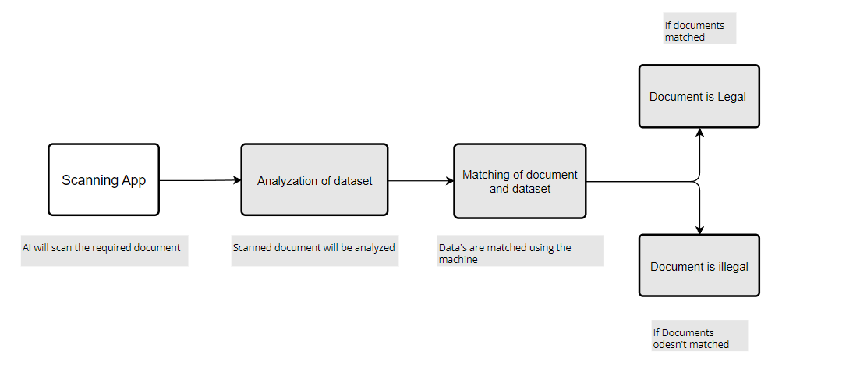
Fraud & Legal | Forgery of Documents
Frauds are occurred in all areas of insurance claim with high severity such as insurance claimed towards auto sector is fraud that widely claimed and prominent type, which can be done by fake accident claim.
So, we aim to develop a project that work on insurance claim data set to detect fraud and fake claims amount. The project implement machine learning algorithms to build model to label and classify claim. We have used machine learning algorithm named “Faster R-CNN” for detection of dataset and built a scanning app which will scan the documents and get matched with the datasets to tell whether the document is legal or forged.

Slide 4
Tech Stack:
Backend:
ScanbotSdk (provides functionality for image operations)
Machine learning (for dataset training)
ScanbotSdk plugins (for integration)
Python libraries (pandas, Matplotlib, Seaborn, NumPy, Sklearn)
Frontend:
Flutter & Dart (for scanning app)
ReactJs
UI/UX
Database:
Kaggle
Sci-kit learn

Slide 5
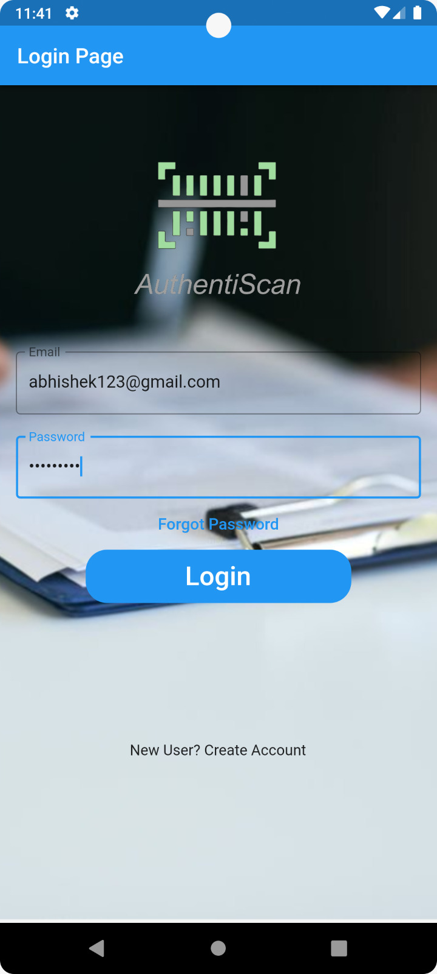
Detailed Description of the solution:
Document capture: Implement a document capture future that allows user to upload to their claim documents securely. This is achieved through a mobile app.
Document Pre-processing: Once the documents are uploaded, perform pre-processing tasks to prepare them for further analysis. This include tasks such as performing image enhancement to improve document legibility.
Optical Character Recognition: Apply OCR (Optical Character Recognition) techniques to extract text from the documents. OCR algorithm convert scanned documents into searchable text. This step is crucial for further analysis.
Text analysis and Natural Language Processing (NLP): Utilized NLP techniques to analyze the document text and to identify entities like names, dates, addresses and policy numbers.
Document verification: Implemented a document verification process that compares the uploaded documents with a database of legitimate and authentic documents.

Slide 6
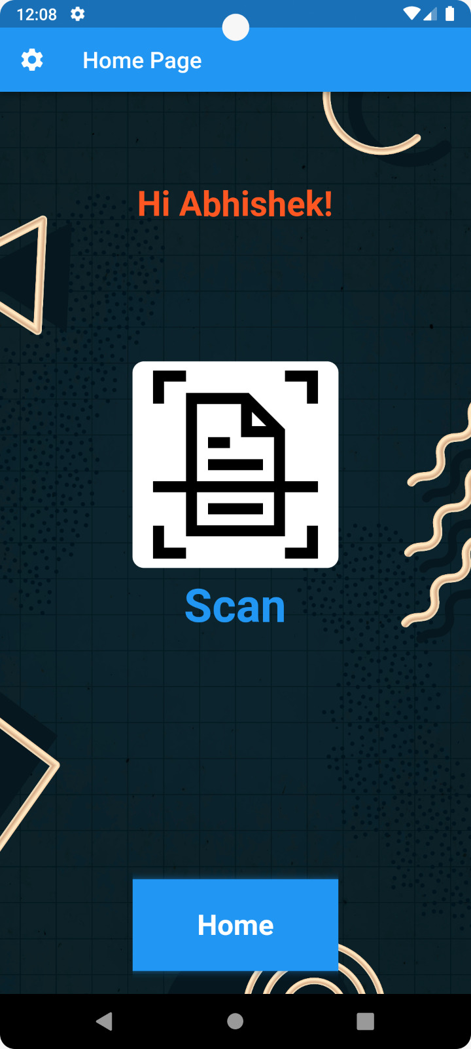
Detailed Description of the solution:
Machine Learning: Developed ML and deep learning model to detect patterns and anomalies in the uploaded documents. Trained the models using a large dataset of authentic and fraudulent documents. The models can learn to identify specific markers or features that indicate potential forgery or tampering. ML algorithms such as decision trees, random forests are used.
Data Integration and Backend: Set up a secure backend system that integrates with various data sources, including insurance databases, claims management systems, and external APIs.

Slide 7
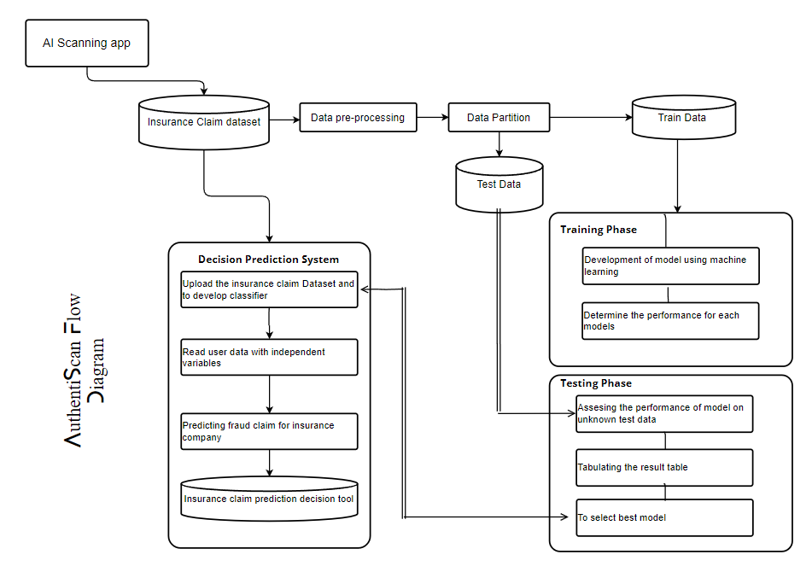
Data Flow Diagram:

Slide 8
USP of our approach:
Advanced AI-powered Fraud Detection: Our app uses latest AI technology to detect fraudulent insurance documents. By using machine learning and natural language processing techniques, it can analyze and identify potential forged patterns and inconsistencies in insurance documents.
Real-Time Document Verification: Not like the traditional manual verification methods, our app provides real-time document verification. This means that insurance companies or users can quickly scan and analyze insurance documents on the spot, allowing quick decision-making and reducing the risk of fraudulent claims being processed. High Accuracy and Efficiency: Our own AI model trained with AIML ensures high accuracy in detecting fraud. By continuously learning and adapting to new fraud patterns, the app becomes more powerful and accurate over time.
User-Friendly Interface: Our app features a user-friendly interface that simplifies the document scanning process. Users can easily capture the documents using the app's built-in scanning feature. The results are presented in a clear and understandable format, allowing our users to quickly identify potential fraud documents.
Cost-Effective Solution: Implementing our app can lead to significant cost savings for insurance companies. The fraud detection process is made easier and faster. Unnecessary payouts for fraudulent claims can be minimized, reducing financial losses and improving overall profitability

Slide 9
USP of our approach:
High Accuracy and Efficiency: Our own AI model trained with AIML ensures high accuracy in detecting fraud. By continuously learning and adapting to new fraud patterns, the app becomes more powerful and accurate over time.
Scalability and Customization: Our app is designed to help growing needs of insurance companies. It can handle a large volume of document verifications without compromising performance. Additionally, the app offers customization options, like coloring, enhancing and cropping of the scanned image according to user preference.

Slide 10
Future possible enhancements:
Advanced anomaly detection: Machine learning algorithms can be further improved to better identify anomalies in insurance claims. By training models on large datasets, including historical fraudulent and legitimate claims, algorithms can learn to identify subtle patterns and indicators of fraud, leading to more accurate detection.
Explainable AI: Transparency and interpretability are important factors in building trust in AI-powered systems. Future enhancements can focus on developing explainable AI models that provide clear explanations and justifications for fraud detection decisions. This can help insurance investigators understand the reasoning behind the system's alerts and facilitate better collaboration between humans and AI.
Unstructured data analysis: Insurance claims often contain unstructured data, such as claim descriptions, medical reports, and images. Future enhancements can involve natural language processing (NLP) and computer vision techniques to analyze and extract meaningful information from unstructured data sources. This can provide valuable insights for fraud detection and analysis.

Slide 11
Risks/ Challenges / Dependencies:
Risks:
False positives and false negatives: Machine learning models are not perfect and can produce false positives (incorrectly flagging legitimate claims as fraudulent) or false negatives (failing to detect actual instances of fraud). These errors can have significant consequences, leading to unnecessary investigations or missed fraudulent activities. Balancing the accuracy of the model while minimizing false results is a challenging task.
Bias in data and algorithms: Machine learning models learn from historical data, and if the training data contains biases, the model may inadvertently perpetuate those biases. Biased data or biased algorithms can result in unfair treatment, such as unfairly targeting certain demographics or missing fraudulent activities that do not fit the historical patterns. It's important to carefully curate the training data and regularly assess and mitigate biases in the model.

Slide 12
Challenges:
Data quality and availability: The quality and availability of data play a crucial role in training effective machine learning models. However, obtaining high-quality labeled data for fraud cases was challenging, as fraud instances are often rare and not well-documented. Additionally, data were incomplete and contained errors, which impacts the accuracy of the models.
Model deployment and integration: Integrating the machine learning models into existing insurance systems and workflows can be complex. Seamless integration requires coordination with IT teams, addressing compatibility issues, and ensuring that the app aligns with the existing infrastructure and processes. Deployment challenges include model versioning, updating, and monitoring for ongoing performance evaluation.
Dependencies:
Data availability: The availability of high-quality, relevant, and diverse data is essential for training accurate and effective machine learning models. Access to historical insurance claim data, including both fraudulent and legitimate cases, is necessary to build a reliable fraud detection system. Collaborating with insurance companies or organizations that can provide such data is crucial.
Expert knowledge: Collaboration with insurance domain experts is crucial for understanding the intricacies of insurance claims and fraud patterns. Domain experts can provide insights into the specific fraud indicators, relevant features, and potential anomalies in the data. Their input is valuable in guiding feature engineering, model development, and defining evaluation metrics that align with industry standards.

Slide 13
Fraud detection: The primary objective of the app is to detect fraudulent activities in insurance claims. This involves building machine learning models that can identify suspicious patterns, anomalies, or indicators of fraud in the data.
Insurance claim analysis: The app also focuses on analyzing insurance claims to gain insights and identify potential fraudulent cases. This analysis may involve examining claim descriptions, supporting documents, transaction records, or other relevant data sources.
Machine learning: The app heavily relies on machine learning techniques to develop predictive models that can effectively detect and analyze fraudulent activities.
Scalability and real-time processing: The app's ability to handle a large volume of insurance claims in real-time is highlighted as a challenge. This requires ensuring scalability, efficiency, and optimized performance of the models to process and analyze claims promptly.
Ongoing monitoring and updates: The need for continuous monitoring of the app's performance, feedback analysis, and model refinement based on new data or evolving fraud patterns is also covered.
Interpretability: The challenge of model interpretability is mentioned, emphasizing the need for transparent explanations of the app's decisions. This aspect involves techniques to provide understandable justifications for fraud detection outcomes.
Acceptance Criteria Coverage:

Slide 14
Anything Else ?
Our app is made using flutter and dart language which has responsive UI and has trained AI model for finding the frauds and fraudulent insurance claims easily.
Some of the extra features which are not enclosed earlier are:
Real-time Fraud Alerts: Implementing real-time fraud alert mechanisms that trigger notifications or alerts whenever a potentially fraudulent document is detected. This feature enables prompt investigation and action, minimizing the potential financial losses and mitigating risks associated with fraudulent claims.
Performance: Showcasing the system's ability to handle large volumes of data and also our app scales with the growing needs of the insurance company.
App Scalability: Our team is constantly working not only on the fraud insurance detections but also on the fraud payment transactions made on the go.
Optimization: Additionally, we are aiming to optimize our software so that it runs error-free and has the best possible probability of detecting fraudulent cases.

